Slide 1
VetChat
“To help veterans around the world to seek help by learning that they are not alone.”

Slide 2

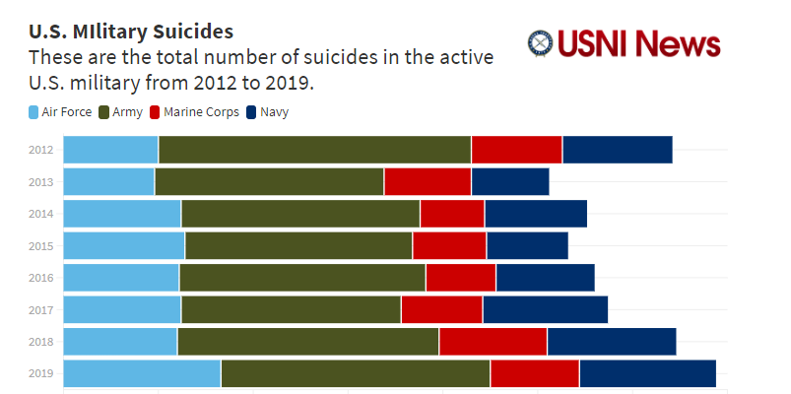
Military Suicide Trends

Slide 3
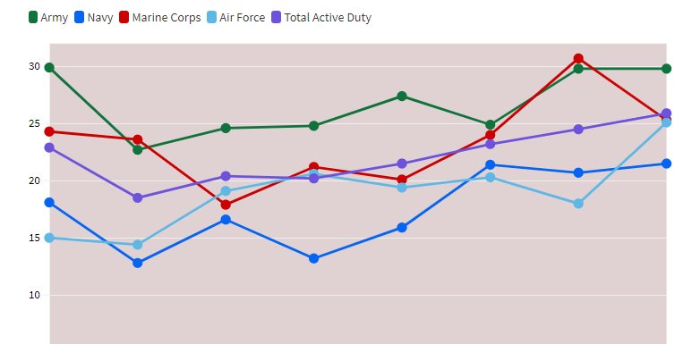
Military Suicide Trends
According to the 2019 Annual DoD report, released on Thursday, the overall rate of deaths by suicide across the services rose from 20.2 deaths per 100,000 in 2015 to 25.9 in 2019.
For the Navy, the rate has risen from a 2018 rate of 20.7 deaths per 100,000 to 21.5 per 100,000 in 2019, or an increase from 68 to 72 individual suicides.
For the Marines, the rate has fallen from a 2018 rate of 30.8 per 100,000 to 25.3 per 100,000 in 2019, or an increase from 57 to 47 individual cases. The Army rates held steady at about 29.8 per 100,000 from 2018 to 2019. The Air Force also saw increases, from a 2018 rate of 18.5 per 100,000 to 25.1 per 100,000 in 2019.

Slide 4
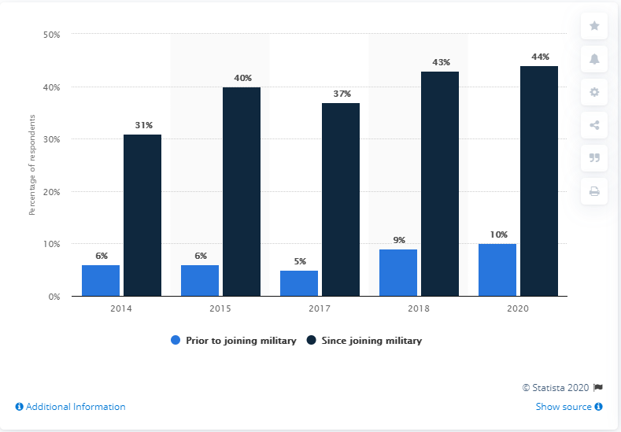
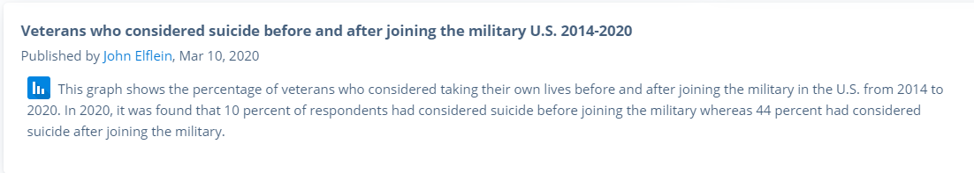

Slide 5
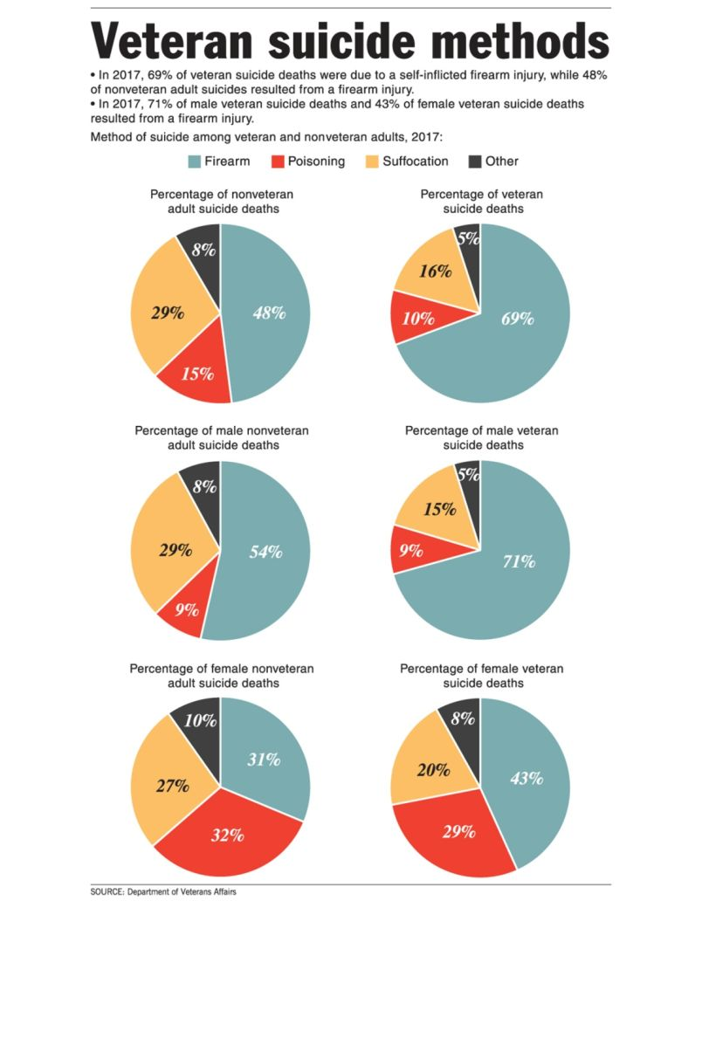

Slide 6
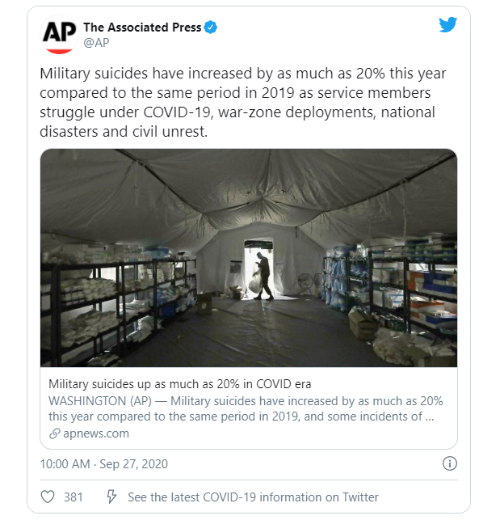
Senior Army leaders told the Associated Press that they have seen about a 30-percent jump in active duty suicides so far in 2020, and they are looking at shortening combat deployments in response (currently at 11 months, due to the extra two weeks of quarantine before and after the usual 10 months of active duty). This move, AP reports, would be part of a broader effort to improve the wellbeing of soldiers and their families.

Slide 7
VetChat purpose
In VetChat, service members or veterans will register and create a profile for identification in which they have the control whether to have their profile visible or not to the eyes of the public. Although the web application is securely for veterans and service members only, most people would want to stay anonymous to keep their identity private. In this manner, they can share their thoughts and experiences freely without exposing their true identity. Also, members of the group would have the ability to send help to any members who have some suspicious actions and members would have the availability to call any hotlines based on what they need in a click.
With the help of this Web Application, service members and veterans would be able to connect with other service members or veterans around the world that can relate to his/her story or their experiences. Therefore, it gives them freedom to talk about what has been bothering them and learn that they are not alone. Having that feeling of not being the only person who has that problem would give relief to their minds and learn how other people cope with the same issues that they have.

Slide 8
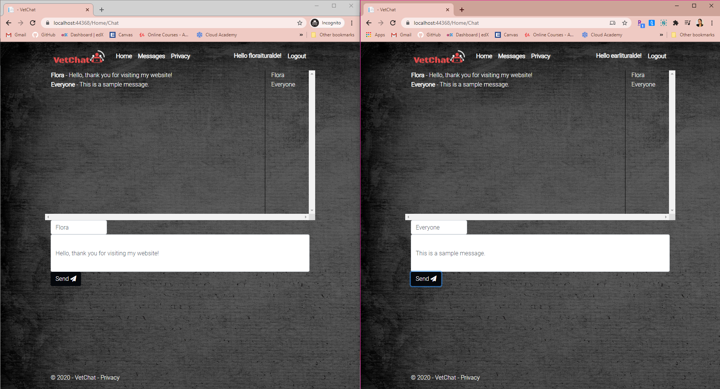
What does my project Include?
SignalR
- ASP.NET SignalR is a library for ASP.NET developers that simplifies the process of adding real-time web functionality to applications. Real-time web functionality is the ability to have server code push content to connected clients instantly as it becomes available, rather than having the server wait for a client to request new data.
- SignalR handles connection management automatically, and lets you broadcast messages to all connected clients simultaneously, like a chat room. You can also send messages to specific clients. The connection between the client and server is persistent, unlike a classic HTTP connection, which is re-established for each communication.

Slide 9
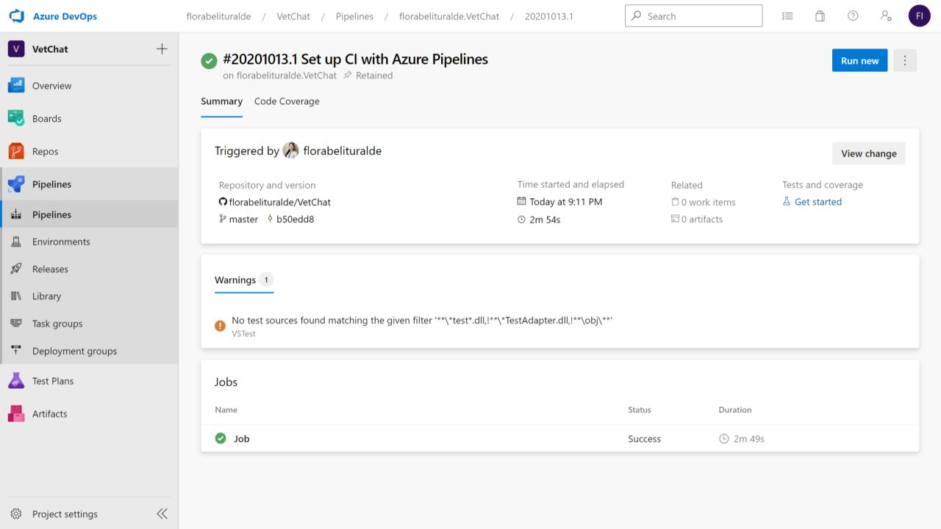
What does my project Include?
Azure DevOps (CI/CD)
- Continuous integration is a software development practice in which developers merge code changes frequently into the main code branch. Continuous integration employs automated testing, which runs every time new code is committed so the code in the main branch is always stable.
- Continuous delivery is the frequent, automated deployment of new application versions into a production environment. By automating the steps required for deployment, teams reduce issues that may occur upon deployment and enable more frequent updates.
View it here on:
https://dev.azure.com/florabelituralde/VetChat

Slide 10
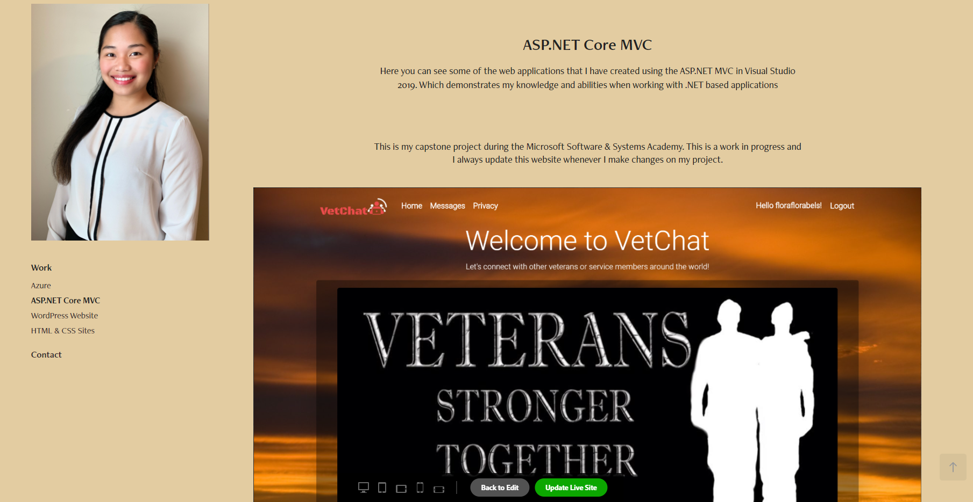
Portfolio Website
You can also view this capstone project in my portfolio here: https://portfolio.adobe.com/ddf31684-54ec-4bd0-b075-035159d51a26/preview/aspnet-core-mvc

Slide 11
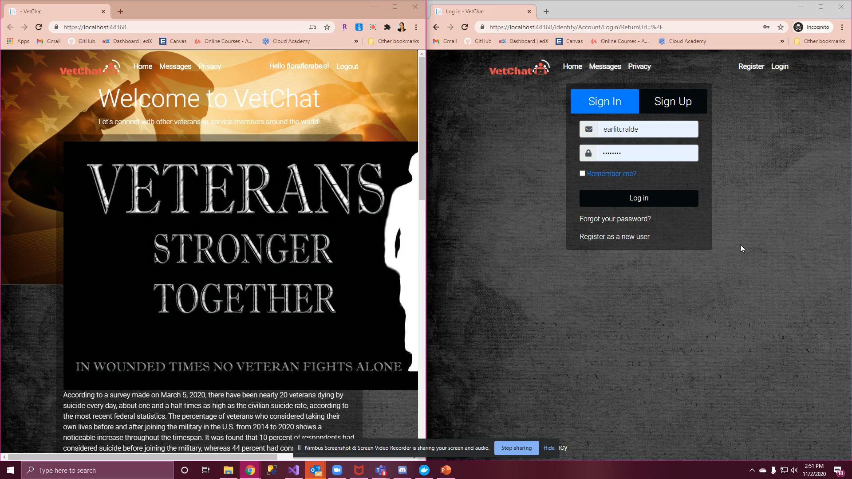
Video Sample of the Project

